Slide 1
Computer Vision Recognition and Positioning

Slide 2
Problem Description
Prove a concept for using computer vision to track a target and automate the electronic control of a phased array.

Slide 3
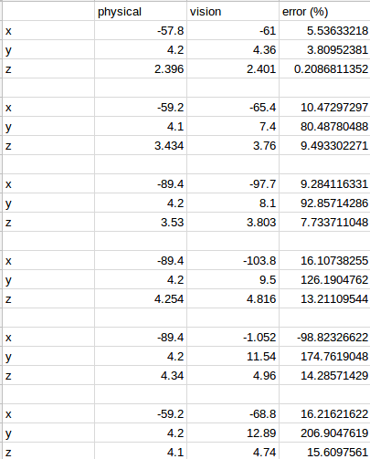
Current Status
Computer vision system can recognize a target and output its position
Position errors are greater towards edges of frame and at greater distance
Need to improve position errors based on

Slide 4
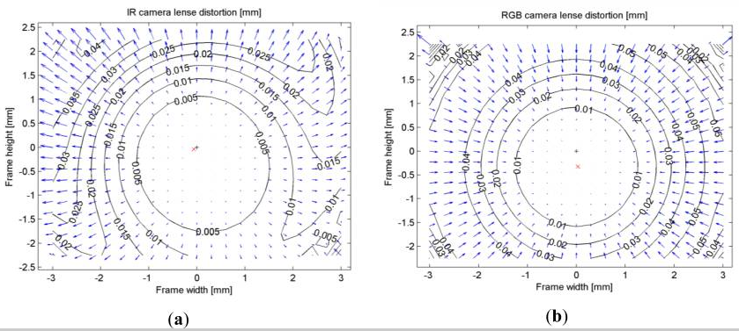
Kholshelham and Elberink. Accuracy and Resolution of Kinect Depth Data for Indoor Mapping Applications.

Slide 5
Current Work
Send steering angles obtained from the computer vision system to an Arduino in real time
Determine test setup and translate the target coordinates to the array coordinates

